Slide 1
Project Integration Management
Project Charter and Project Management Plan

Slide 2
Developing a Project Charter
After top management decides which projects to pursue, it is important to let the rest of the organization know about these projects.
Management needs to create and distribute documentation to authorize project initiation.
This documentation can take many different forms, but one common form is a project charter.

Slide 3
A project charter is a document that formally recognizes the existence of a project and provides direction on the project’s objectives and management.
It authorizes the project manager to use organizational resources to complete the project.
Ideally, the project manager plays a major role in developing the project charter.

Slide 4
Instead of project charters, some organizations initiate projects using a simple letter of agreement, while others use much longer documents or formal contracts.
Key project stakeholders should sign a project charter to acknowledge agreement on the need for and intent of the project.
A project charter is a key output of the initiation process.

Slide 5
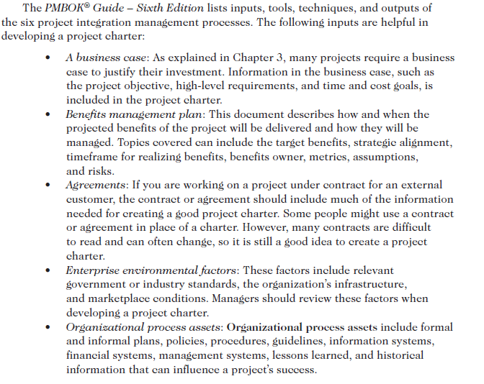

Slide 6
Project Charter
• The project’s title and date of authorization
• The project manager’s name and contact information
A summary schedule, including the planned start and finish dates; if a
summary milestone schedule is available, it should also be included or
referenced
• A summary of the project’s budget or reference to budgetary documents
• A brief description of the project objectives, including the business need or
other justification for authorizing the project
• Project success criteria, including project approval requirements and who
signs off on the project
• A summary of the planned approach for managing the project, which should
describe stakeholder needs and expectations, important assumptions,
and constraints, and should refer to related documents, such as a
the communications management plan, as available
• A roles and responsibilities matrix
• A sign-off section for signatures of key project stakeholders
• A comments section in which stakeholders can provide important comments
related to the project

Slide 7
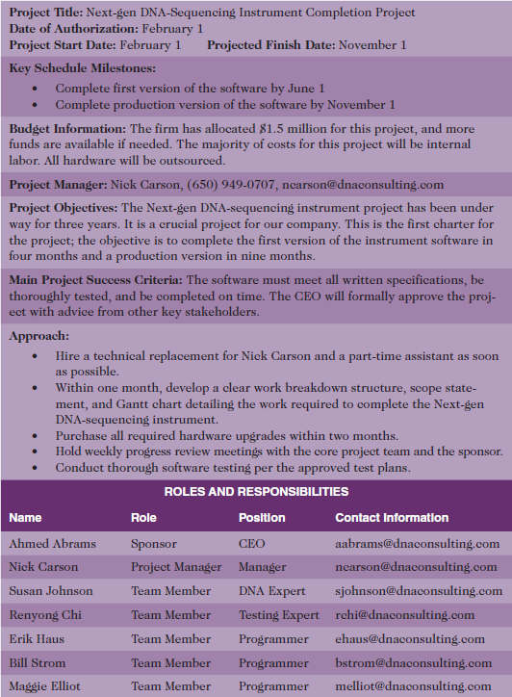

Slide 8
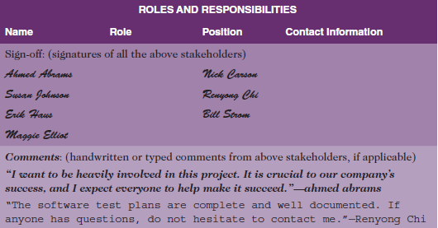

Slide 9
Developing a Project Management Plan
To coordinate and integrate information across project management knowledge areas and across the organization, there must be a good project management plan.
A project management plan is a document used to coordinate all project planning documents and help guide a project’s execution and control.
Plans created in the other knowledge areas are considered subsidiary parts of the overall project management plan.
Project management plans also document project planning assumptions and decisions regarding choices, facilitate communication among stakeholders, define the content, extent, and timing of key management reviews, and provide a baseline for progress measurement and project control.
Project management plans should be dynamic, flexible, and subject to change when the environment or project changes.

Slide 10
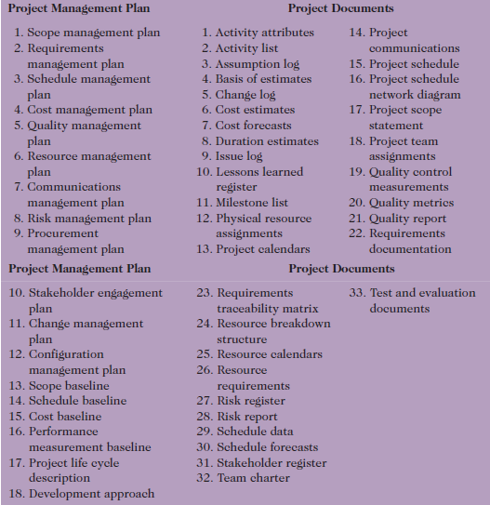
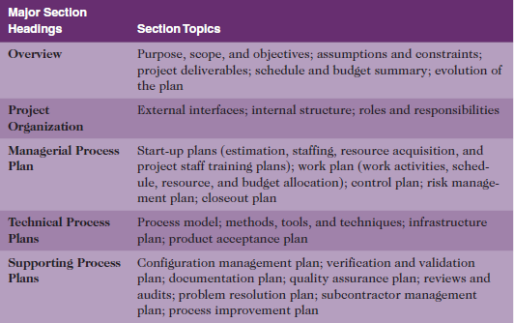
Sample contents for the IEEE software project management plan (SPMP)
Project management plan and project documents

Slide 11
Directing and managing project work, which involves carrying out the project plans by performing the activities included in it. Project plan execution usually requires the majority of a project’s budget.
• Managing project knowledge, which involves using existing knowledge and creating new knowledge to achieve project objectives while also contributing to organizational learning.
• Monitoring and controlling project work, which is necessary to meet the performance objectives of the project. The project team should continuously monitor project
performance to assess the overall health of the project.
• Performing integrated change control, which involves identifying, evaluating, and
managing changes throughout the project life cycle. A change control system often
includes a change control board (CCB), configuration management, and a process for
communicating changes.
• Closing the project or phase involves finalizing all project activities. It is important to
follow good procedures to ensure that all project activities are completed and that the
project sponsor accepts delivery of the final products, services, or results.

Slide 12
Several types of software products are available to assist in project integration management.
Be sure to consider how project integration management can differ in agile/adaptive environments.

